Slide 1
ELECTRONIC SAMPLE QUESTIONS

Slide 2
SEMICONDUCTORS
PLEASE READ EVERYTHING ABOUT SEMICONDUCTORS IN THE SLIDES

Slide 3
IDEAL DIODE QUESTIONS

Slide 4
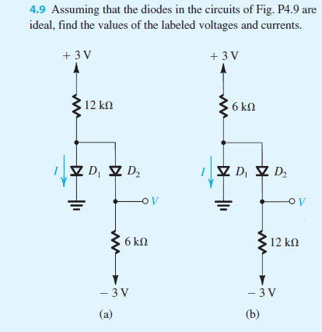
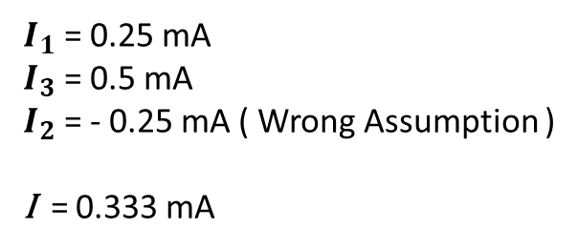
$I_{1}$ = 0.25 mA
$I_{3}$ = 0.5 mA
$I_{2}$ = - 0.25 mA ( Wrong Assumption )
I = 0.333 mA

Slide 5
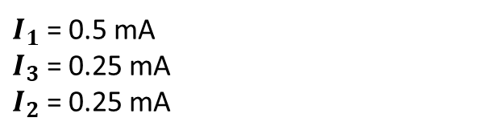
$I_{1}$ = 0.5 mA
$I_{3}$ = 0.25 mA
$I_{2}$ = 0.25 mA

Slide 6
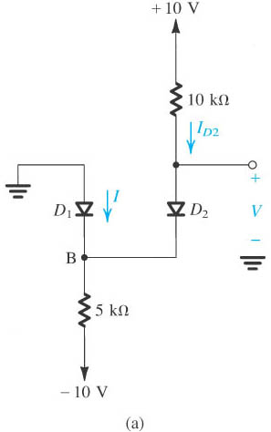
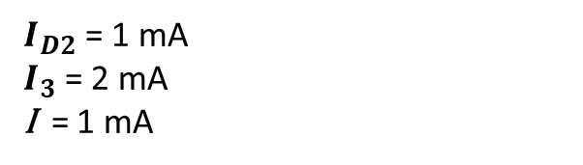
$I_{D2}$ = 1 mA
$I_{3}$ = 2 mA
I = 1 mA

Slide 7
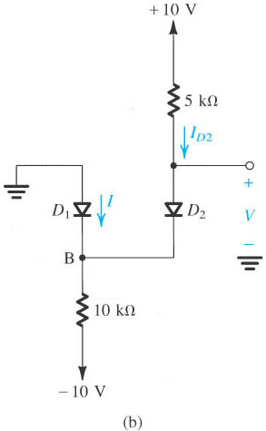
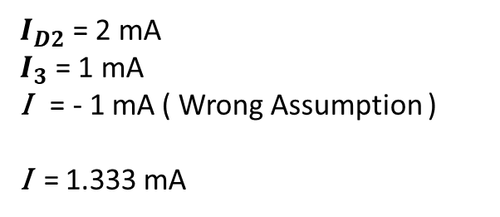
$I_{D2}$ = 2 mA
$I_{3}$ = 1 mA
I = - 1 mA ( Wrong Assumption )
I = 1.333 mA

Slide 8
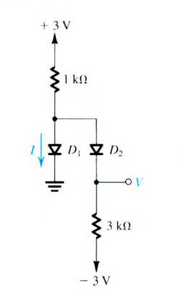
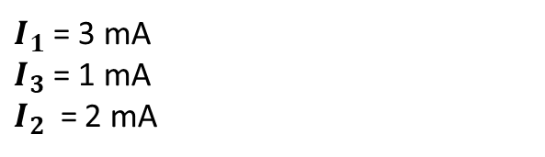
$I_{1}$ = 3 mA
$I_{3}$ = 1 mA
$I_{2}$ = 2 mA

Slide 9
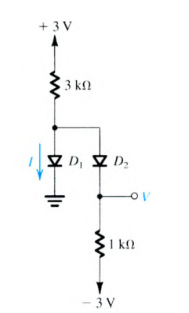
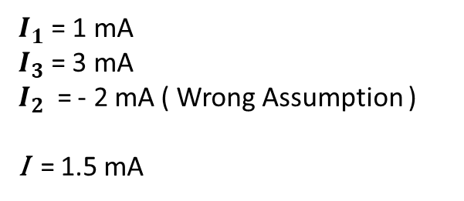
$I_{1}$ = 1 mA
$I_{3}$ = 3 mA
$I_{2}$ = - 2 mA ( Wrong Assumption )
I = 1.5 mA

Slide 10
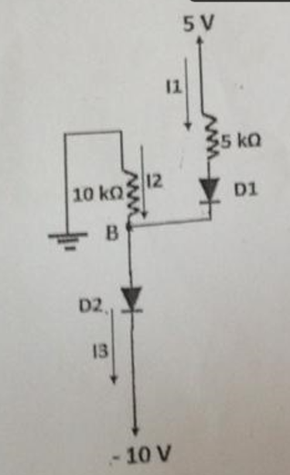
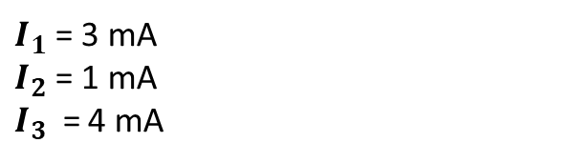
$I_{1}$ = 3 mA
$I_{2}$ = 1 mA
$I_{3}$ = 4 mA

Slide 11
ITERATIVE ANALYSIS QUESTIONS

Slide 12
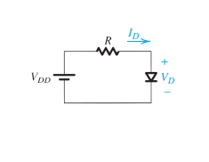
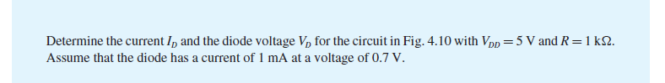

Slide 13
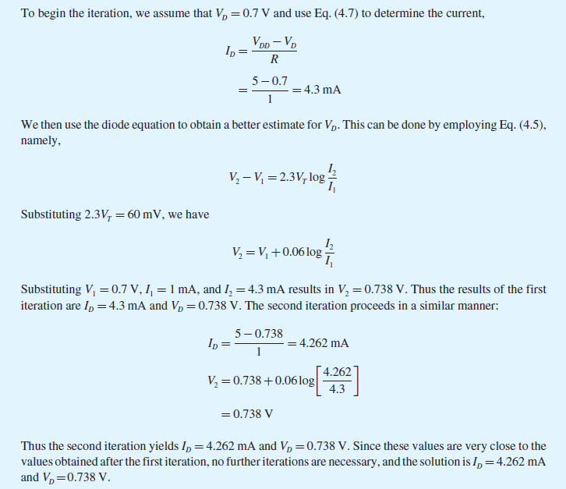

Slide 14
PIECEWISE LINEAR MODEL QUESTIONS

Slide 15
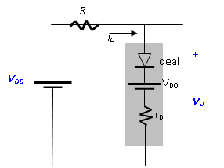
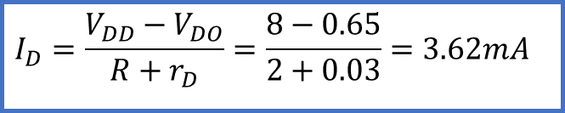
Example Piece-Wise Model
Repeat the problem solved earlier with iterative analysis, utilizing the piecewise-linear model. (Take V_{DD} = 8 V R = 2 kΩ V_{DO} = 0.65 V and r_{D} = 30 Ω)
R
I
+
V_{DD}
-
V_{D}
Kirchoff loop equation for the equivalent circuit
$$I_{D}=\frac{V_{DD}−V_{DO}}{R+r_{D}}=\frac{8−0.65}{2+0.03}=3.62mA$$
The diode voltage can now be:
$$V_{D}=V_{DO}+I_{D}r_{D}=0.65+3.62×0.03=0.758V$$

Slide 16
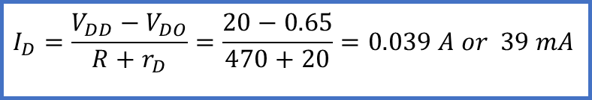
Example Piece-Wise Model
Repeat the problem solved earlier with iterative analysis, utilizing the piecewise-linear model. (Take V_{DD} = 20 V R = 470 Ω V_{DO} = 0.65 V and r_{D} = 20 Ω)
R
I
+
V_{DD}
-
V_{D}
Kirchoff loop equation for the equivalent circuit
$$I_{D}=\frac{V_{DD}−V_{DO}}{R+r_{D}}=\frac{20−0.65}{470+20}=0.039 A or 39 mA$$
The diode voltage can now be:
$$V_{D}=V_{DO}+I_{D}r_{D}=0.65+0.039×20=1.43 V$$

Slide 17
VOLTAGE DROP OR CONSTANT DROP MODEL QUESTIONS

Slide 18
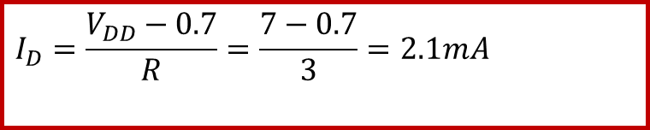
Example Voltage Drop Model
Determine the current I_{D} and the diode voltage V_{D} for the circuit in Figure 5. With V = 7 V and R = 3 kΩ.
Let’s solve the same problem using the constant-drop-voltage model.
We obtain;
$$I_{D}=\frac{V_{DD}−0.7}{R}=\frac{7−0.7}{3}=2.1mA$$

Slide 19
BIPOLAR JUNCTION TRANSISTOR ( BJT)

Slide 20
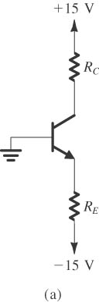
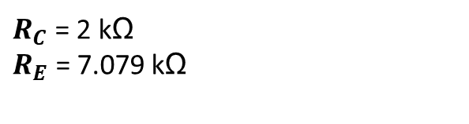
QUESTION 1
The npn transistor has beta=100 and exhibits an Ic=1mA at VBE=0.7V. Design the circuit so that a current of 2mA flows through collector and a voltage of +5V appears at the collector.
$R_{C}$ = 2 kΩ
$R_{E}$ = 7.079 kΩ

Slide 21
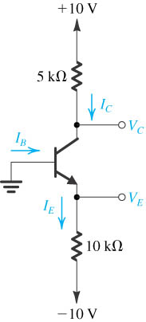
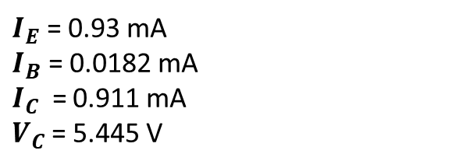
QUESTION 2
The voltage at the emitter was measured and found to be -0.7V. If beta=50, find IE, IB, IC and VC.
$I_{E}$ = 0.93 mA
$I_{B}$ = 0.0182 mA
$I_{C}$ = 0.911 mA
$V_{C}$ = 5.445 V

Slide 22
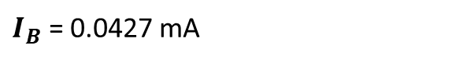
QUESTION 3
The npn transistor has beta=100 and emitter current, I_{E} = 4.3 mA what is the value of the base current?
$I_{B}$ = 0.0427 mA

Slide 23
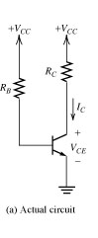
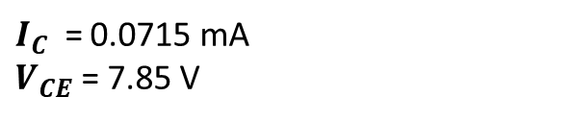
QUESTION 4
RB=200kΩ, RC=1kΩ, VCC=15V, beta=100. Solve for IC and VCE
$I_{C}$ = 0.0715 mA
$V_{CE}$ = 7.85 V

Slide 24
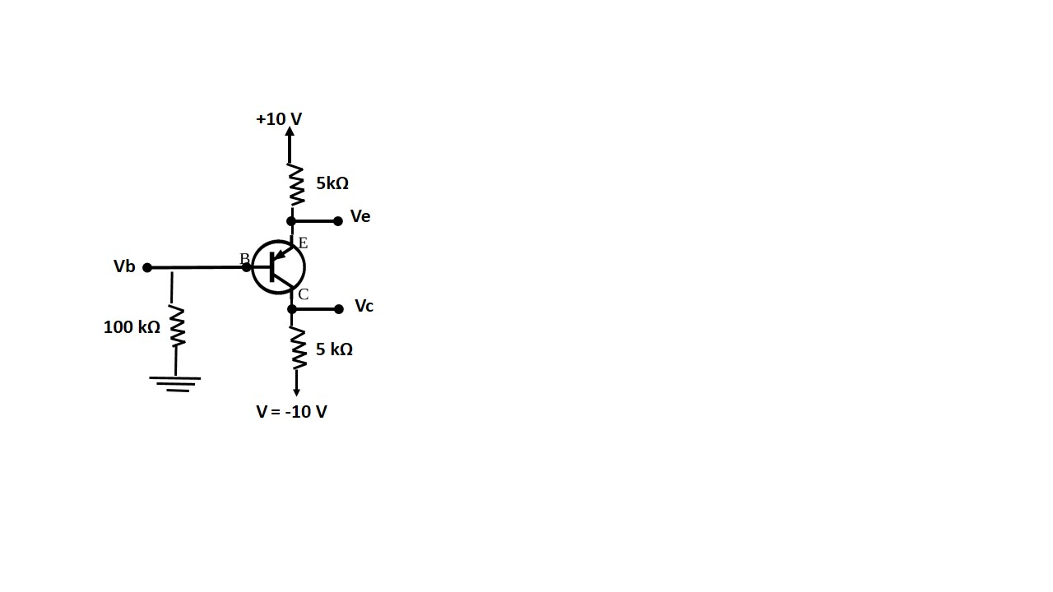
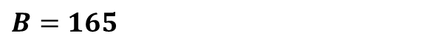
QUESTION 5
In the circuit shown below, measurement indicates V_{B} to be +1.0V and V_{E} to be +1.7V. What is β for this transistor?
$$B=165$$

Slide 25
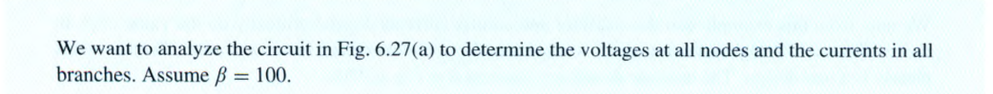
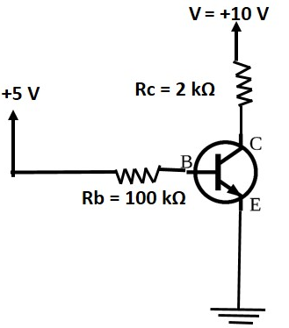
QUESTION 6

Slide 26
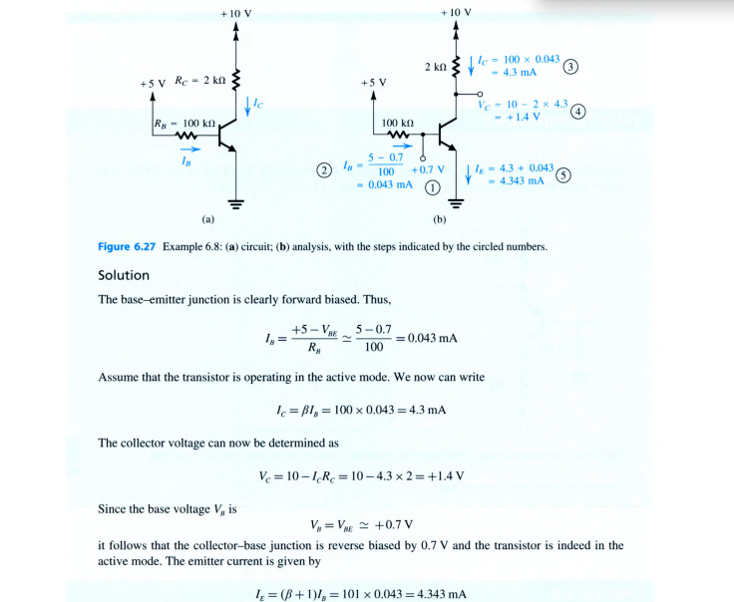

Slide 27
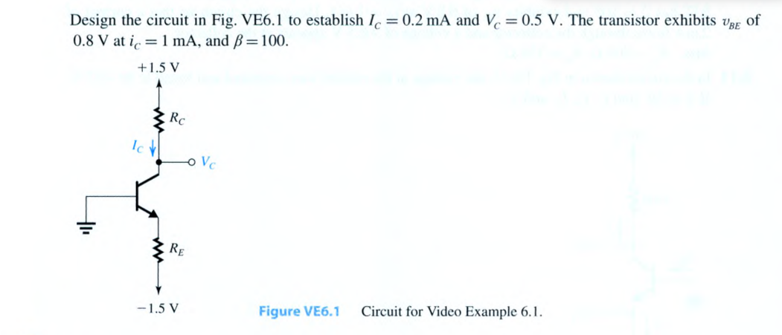
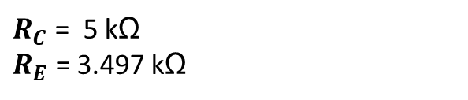
QUESTION 7
$R_{C}$ = 5 kΩ
$R_{E}$ = 3.497 kΩ

Slide 28
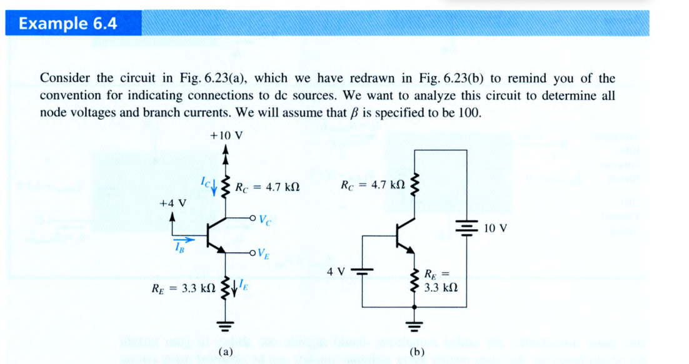
QUESTION 8

Slide 29
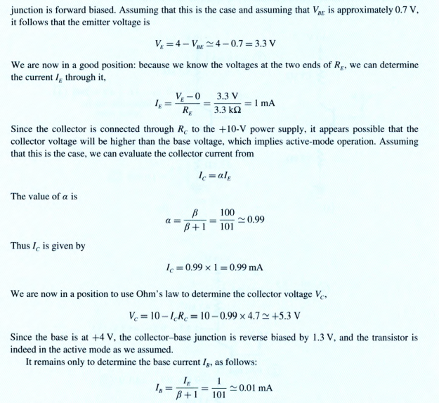

Slide 30
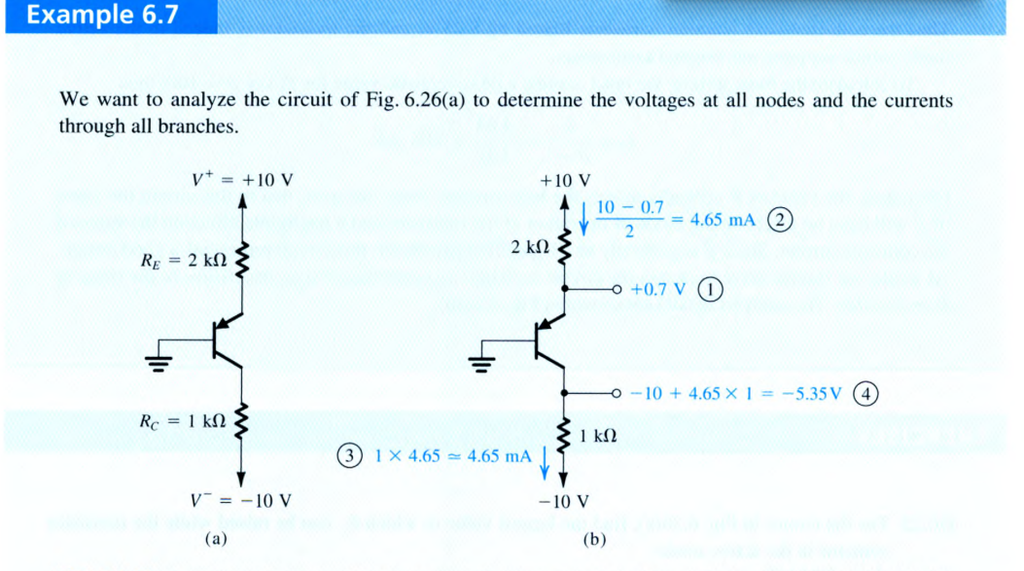
QUESTION 9

Slide 31
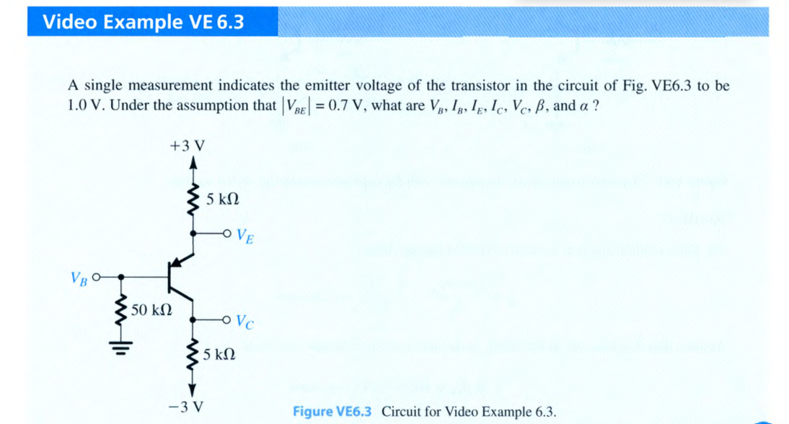
QUESTION 10

Slide 32
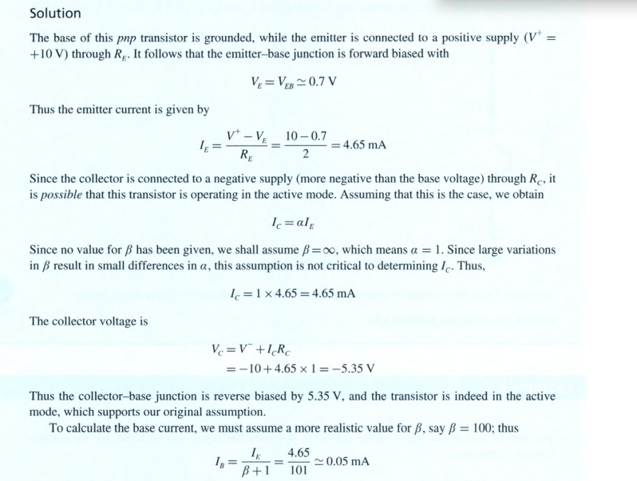

Slide 33
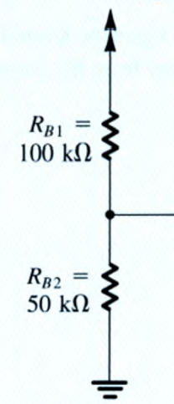
VOLTAGE DIVIDER
Vin
Vin
Vo = Vout + ( Current (I) x Vin)
Vout = 0V ( Grounded) Vo = 0 + ( Current (I) x Vin)
Vo = Vout + ( Current (I) x Vin)
Vo
Vo
Vout
Vout

Slide 34
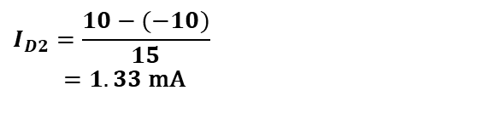

Assume that D₁ is off, and D₂ is on.
$$I_{D2}=\frac{10−(−10)}{15}$$
$=1.33 \text{mA}$
Vo = Vout + ( Current (I) x Vin)
$$V_{B}=−10+\left( 10×1.33\right)=+3.3 \text{V}$$
$$V=3.3 \text{V}$$

Slide 35
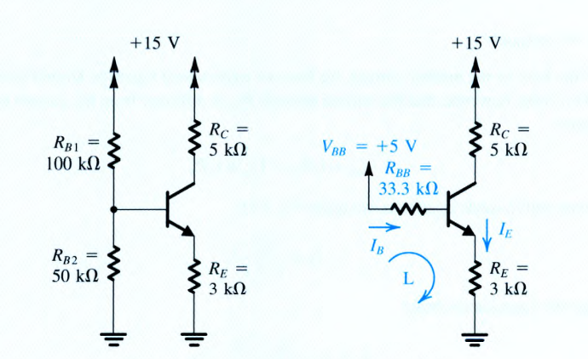
QUESTION 11
Find the Thevenin’s equivalent circuit

Slide 36
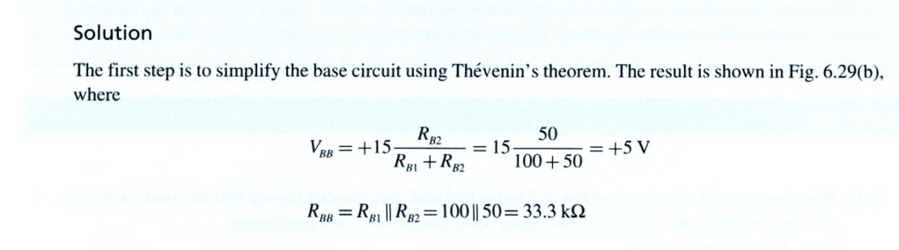
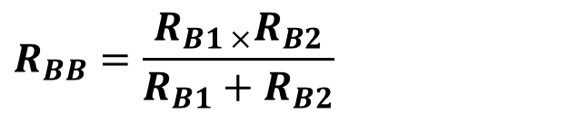
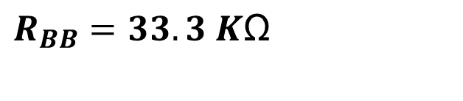
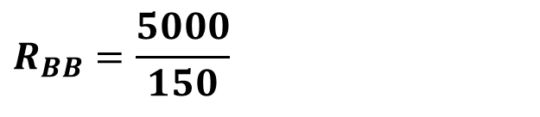
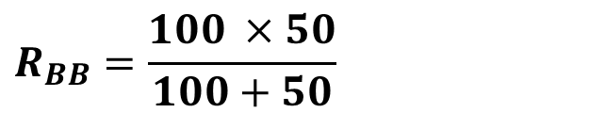
$$R_{BB}=\frac{R_{B1 ×}R_{B2}}{R_{B1}+R_{B2}}$$
$$R_{BB}=\frac{100 ×50}{100+50}$$
$$R_{BB}=\frac{5000}{150}$$
$$R_{BB}=33.3 K\text{Ω}$$

Slide 37
COMPILED BY TA JOHN.
ALL THE BEST IN YOUR EXAMINATION

Slide 38
THANK YOU.

